Slide 1
Development of Grammatical Tone in Northern Toussian
Anthony Struthers-Young
asy3661@gmail.com

Slide 2
Languages and Geography
The Toussian languages are members of the Gur family
There are 2, maybe 3 Toussian languages
  Northern Toussian
  Southern Toussian
  Moami Kan, the language of two villages, Moami and Tin
Spoken in southwest Burkina Faso, to the southwest of Bobo-Dioulasso and to the north and east of Orodara

Slide 3
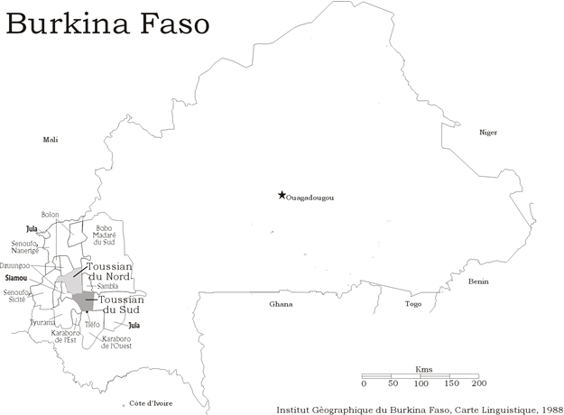

Slide 4
Grammatical tone of Northern Toussian
I will be discussing a specific type of grammatical tone
  modulation of tone
  prolongation of the vowel
At Djigouera (NT), there is only 1 example of this type grammatical tone. However, at Kourinion (NT), there are 6
I will give data from Kourinion (NT) in blue, data from Djigouera (NT) in orange, data from Wempéa (ST) in green, and reconstructions in grey

Slide 5
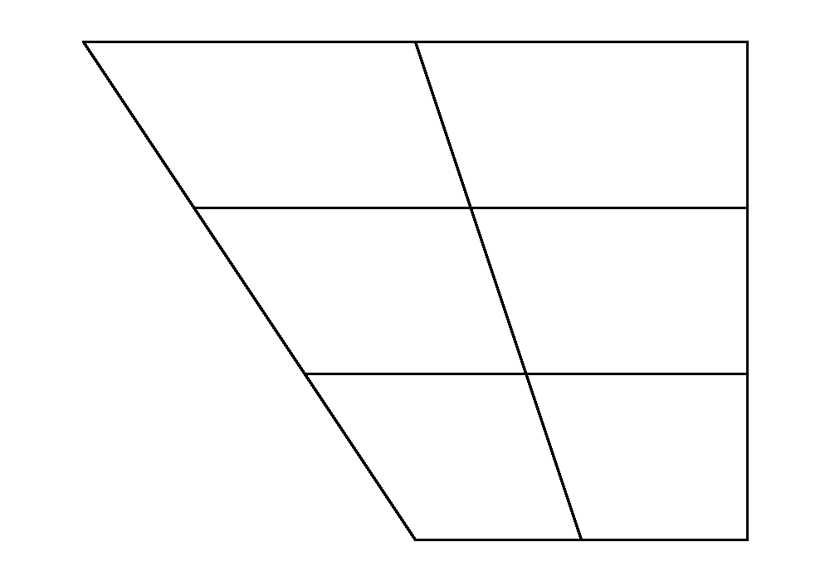
Relevant phonology of Northern Toussian of Kourinion
2~3 glottalized vowels
/aˀ œˀ/ and ɛˀ, either a phoneme or allophone of /œˀ/
Vowel length is not phonemic
3 flat tones
  H (high)
  M (mid)
  L (low)
(potentially) 3 lexical contour tones
  HM, ML, LH
The palatal glide is written as y
i
u
ʉ
e
ɛ
ɔ
a

Slide 6
Description of the phenomenon
There are 3 types of prolongation accompanied by tonal modulation
  1 with a contour of LH
  1 which resolves at H
  1 which resolves at M
They are found in 6 different constructions
  On nouns in an identificational construction ‘it’s X’
  On WH words in questions
  On nouns which serve as complements following the main verb
    the typical word order is S Aux O V X, where X is various adverbs and postpositional phrases
  On verbs in hypothetical conditional constructions
  On verbs in future constructions
  (slightly differently) as an alternative to the ipfv pɛ̰̄
This phenomenon is found in only one construction in the dialect of Djigouera.

Slide 7
Identificational construction
Prolongation of the vowel, and the tone resolves at H
  sú ‘father’; súú ‘it’s father’
  lɛ̀ ‘uncle’: lɛ̀ɛ́ ‘it’s uncle’
If the word ends in an offgliding dipthong, the second vowel of the diphthong is lengthened, appearing as a full vowel rather than a glide
  kāy ‘wife’; kāí

Slide 8

WH words
Interrogative phrases which begin with a WH word bear the same tonal modulation as the identificational construction
  ńwʉ̀ ‘who?’
ńwʉ̀ʉ́ wœ̄ˀ mɛ̰̄ ma̰᷆
who.long house dem build
‘Who built this house?’

Slide 9
On nominal complements which follow the verb
There are certain constructions which have this phenomenon when the complement is postponed to after the verb. Typically, they end on a M
mú ká̰ pʉ́ʉ̄
1sg give money.long
‘give me money’
tá̰ˀ wʉ̄ pāy plɛ́ɛ̄
caterpillar default? do butterfly.long
‘the caterpillar became a butterfly’

Slide 10
Future constructions
Marked by a future morpheme pīŋ and a tonal modulation in the form LH
à pīŋ wɔ́ɔ̌
3sg fut leave.long
‘he will leave’
nɔ̄ kʉ́ pīŋ bār pāǐ n̄sɛ̀nà
1pl neg fut work (n) do.long tomorrow
‘we won’t work tomorrow’

Slide 11
Hypothetical idea in a conditional clause
106. [The speaker knows the boy was expecting money and that he did not get it] If the boy GET the money (yesterday), he BUY a present for the girl
à náˀ kʉ̄ à pʉ́ wɛ̄ à náˀ nī cadeau dwíǐ à pī kā̰
3sg past inc† det money get 3sg past subj? gift buy.long 3sg girl give
‘had he gotten the money, he would have bought a gift and given it to the girl’
The apodosis is in a hypothetical phrase; the fact that he didn’t get money is known. What is unknown is if the girl had received the gift.
You can prolong the vowel and modulate the tone of either the first or the second verb of the apodosis, but not both
In fast speech, the contour is simplified to H
†kʉ̄ is a morpheme that is used with either the past marker or a conditional morpheme; it indicates that the action is unachieved.
Notes:
Östend Dahl 1985, Tense and Aspect systems

Slide 12
105. [The speaker knows the boy was expecting money, but he doesn't know if he got it] If the boy GET the money (yesterday), he BUY a present for the girl
à náˀ kʉ̄ à pʉ́ wɛ̄ɛ̄ tāy
3sg past inc det money get.long in that case
à náˀ nī cadeau dwí à pī kā̰
3sg past subj? gift buy 3sg girl give
‘In the case that, if he got the money, he bought a gift and gave it to the girl’
It is not known if the boy received the money, therefore the first proposition is hypothetical. However, one would suppose that the boy would purchase the gift for the girl if the first proposition came to fruition.

Slide 13
Alternative to the ipfv morpheme
Imperfective particle pɛ̰̄, found in Aux position
Can be replaced by ɛ̄ˀ in certain circumstances
sɔ̰᷇-nā lʉ᷇=ɛ̄ˀ súwœ́ˀ=la᷇
3pl-pl also(many/all)=ipfv alone=interrogative
‘are they also different?’
Replacing with pɛ̰̄ would have the same sense
pɛ̰̄ cannot be replaced by ɛ̄ˀ in all contexts
Different type of phenomenon, but has important implications

Slide 14
One parallel in the Northern Toussian of Djigouera
In variety spoken at Djigouera, only the identificational construction bears this same prolongation and tonal modulation.
  sú ‘father’; súú ‘it’s the father’
  lè ‘uncle’; lèé ‘it’s the uncle’
All of the other constructions are formed by other means, either with particles, postpositions, or other morphemes

Slide 15
Hypotheses of the prolongation and tonal modulation
The Northern Toussian of Djigouera and Kourinion are varieties of the same language, although hardly mutually intelligible. How did this difference in grammatical tone arise?
Most of the differences can be traced to phonological attrition, leaving a morpheme lacking segmental content, bearing only tone
The following slides will show my hypotheses of the development of the phenomenon

Slide 16
yé, identificational morpheme in Southern Toussian
Southern Toussian forms the identificational construction by a clitic
  =yé
  pà̰ˀ=yé ‘it’s a dog’; often reduced to a glide [pǎ̰ˀy]
Potentially the origin of Northern Toussian identificational construction

Slide 17
WH words
ńwʉ̀ʉ́ wœ̄ˀ mɛ̰̄ ma̰᷆
who.long house dem build
‘Who built this house?’
I believe this to be a reflex of the identificational construction, similar to the French construction qui est-ce qui a construit la maison

Slide 18
=sɛ̄, a general postposition used with postverbal complements
The variety at Djigouera uses the postposition =sɛ̄ in many postverbal contexts
  most contexts are identical to the contexts where the prolongation and modulation is found at Kourinion
  Generally, it means ‘with,’ but is used in many lexicalized idioms
Comparison between the two dialects:
Kourinion: ‘give me money’ mú ká̰ pʉ́ʉ̄
1sg give money.long
Djigouera: ‘give me money’ mɔ̰᷇ kɔ̰́ po᷇=sɛ̄
1sg give money=obl
Kourinion: ‘the caterpillar became a butterfly’ tá̰ˀ wʉ̄ pāy plɛ́ɛ̄
caterpillar default? do buterfly.long
Djigouera: ‘the caterpillar became a butterfly’ tíə̄ŋ pɛ́y sə̄ple᷇=sɛ̄
caterpillar do butterfly=obl

Slide 19
Lenition of *s
The lengthening and =sɛ̄ seem to be related, that the *s of *sɛ̄ lenited, after which the vowels merged, leaving only the lengthened vowel and tone
There appears to be another morpheme which has a similar history
  Kourinion hɔ̰̄ ~ Djigouera sə̄ŋ ‘under,’ ‘anus’
  hɔ̰̄ is found in many compounds: kɔ̰́hɔ̰̄ ‘armpit,’ lit. ‘under-shoulder’; sùdɔ̀hɔ̰̄ ‘morning,’ the meaning of sùdɔ̀ is not known by my consultant
  It can be used as a postposition, meaning ‘under X,’ e.g. súpyʉ̀ɣ=hɔ̰̄ ‘under a tree’
I don’t have a solid context for this sound change, though it most likely isn’t conditioned by being in an intervocalic position
  pʉ̀sʉ̄ɣ ‘smoke.’
  Perhaps it is due to stress interactions of the clitic

Slide 20
Conservation of *s
Though s is lost on nouns in postverbal constructions, it is found after pronouns
‘give it to me’ mú ká̰ kʉ́=hɛ̰̄
1sg give 3sg.nh=obl
OR
mú ká̰ kʉ́=sɛ̰̄
1sg give 3sg.nh=obl
=hɛ̰̄ and =sɛ̰̄ are interchangeable
Consonants preserved because they are interacting with clitics?

Slide 21
Alternative to pɛ̰̄
sɔ̰᷇-nā lʉ᷇=ɛ̄ˀ súwœ́ˀ=la᷇
3pl-pl also(many/all)=ipfv alone=interrogative
‘are they also different?’
This appears to similar to the prior two examples, only vowel quality has not yet degraded

Slide 22
Hypotheses for the hypothetical and future construction
We’ve seen explanations for 4 of the 6 constructions presented
  Postverbal nouns are due to the phonological erosion of a postposition found in Djigouera as sɛ̄
  Nouns in identificational constructions due to the attrition of a clitic found in Southern Toussian as yé
  WH words as a reflex of the identificational construction
  Replacement of pɛ̰̄ possibly like sɛ̄ and yé, only in the process of attriting
Future construction and hypothetical conditional construction are left
  My hypothesis is more tentative

Slide 23
How does Djigouera Toussian treat future constructions and conditionals?
Djigouera pī, cognate to Kourinion pīŋ – but no prolongation
Kourinion: à pīŋ wɔ́ɔ̌
3sg fut leave.long
‘he will leave’
Djigouera: à pī wn̄
3sg fut leave
‘he will leave’
The conditional construction uses different irrealis particles, and notably lacks the prolongation

Slide 24
106. [The speaker knows the boy was expecting money and that he did not get it] If the boy GET the money (yesterday), he BUY a present for the girl
Kourinion:
à náˀ kʉ̄ à pʉ́ wɛ̄
3sg past inc† det money get
à náˀ nī cadeau dwíǐ à pī kā̰
3sg past subj? gift buy.long 3sg girl give
‘had he gotten the money, he would have bought a gift and given it to the girl’
à=á sə́nɔ́ po᷇ wē à=á cadeau dí nə̀ ínə̄ɣ kɔ̰
3sg=past irr money get 3sg=past gift buy SS† girl give
‘if he had gotten the money, he would have bought a gift and given it to the girl’
† This is a morpheme that indicates that there has been no change in subject between clauses, somewhat like a same subject marker in switch reference systems

Slide 25
105. [The speaker knows the boy was expecting money, but he doesn't know if he got it] If the boy GET the money (yesterday), he BUY a present for the girl
Kourinion:
à náˀ kʉ̄ à pʉ́ wɛ̄ɛ̄ tāy
3sg past inc det money get.long in that case
à náˀ nī cadeau dwí à pī kā̰(T?)
3sg past subj? gift buy 3sg girl give
‘In the case that he received the money, he bought a gift and gave it to the girl’
Djigouera:
à=á sə́nɔ́ po᷇ wē à=á cadeau dí nə̀ ínə̄ɣ kɔ̰
3sg=past irr money get 3sg=past gift buy SS girl give
‘if he had gotten the money, he would have bought a gift and given it to the girl’

Slide 26
No obvious parallel
The ways of expressing modality are quite divergent between the two varieties, with several different morphemes and constructions
There is no obvious source of grammaticalization, as there is for the other examples we’ve looked at

Slide 27
Movement of auxiliaries in the Toussian of Djigouera
Auxiliaries typically are found between the subject and the verb
There is an example of an auxiliary which can move to the end of the phrase
à=á wn̄
3sg=past leave
‘He left (a long time ago)’
à wn̄=á
3sg leave=past
‘He left’
This is the only example I’ve yet to find of an auxiliary which can move like this.

Slide 28
Modality in the Toussian of Djigouera
Two particles pə́ and sə́(nɔ́)
sə́ is a dubitative particle
à sə́ wn̄
3sg dub leave
‘(I doubt that) he left’
pə́ is an irrealis particle
á̰ yɔ̄ à pə́ wn̄
1pl say 3sg irr leave
‘It’s as if (lit. we say that) he left’

Slide 29
pə́ and sə́, potential sources
We’ve seen that pɛ̰̄ lost its initial consonant, as well as *sɛ̄
Additionally, we saw an auxiliary placed at the end of the phrase
Potentially the earlier forms of pə́ and sə́ in the variety of Kourinion were phrase final
  Later attrited
However, this hypothesis is tentative, because only á can move in that manner synchronically

Slide 30
Conclusion/things of note
This one phenomenon has developed and spread widely in a dialect mutually intelligible to a dialect which has not spread the phenomenon
The prolongation and modulation potentially come from several different words with very different initial consonants, such as yé, *sɛ̄, pɛ̰̄, and maybe the ancestor of pə́ and sə́, dropping the initial consonant and merging with the vowel
Tone plays an important role in all of them, but the LH contour doesn’t make a great deal of sense historically, though I’m sure more can be gleaned with more data and analysis

